Slide 1
Writing Tests. TDD
Continuous staff improvement project
Ion Gandrabura

Slide 2
Introduction
Writing tests using NUnit.
Test, TestFixture, TestCase, etc.
Organizing unit-tests.
Moq.
TDD.
Introduction. Benefits. Test driven approach.

Slide 3
NUnit
NUnit is a unit-testing framework for all .Net languages.
Initially ported from JUnit.
It is written entirely in C# and has been completely redesigned to take advantage of many .NET language features, for example custom attributes and other reflection related capabilities.
Unit testing is used to test a small piece of workable code (operational) called unit.

Slide 4
AAA Pattern
Arrange: setup everything needed for the running the tested code. This includes any initialization of dependencies, mocks and data needed for the test to run.
Act: Invoke the code under test.
Assert: Specify the pass criteria for the test, which fails it if not met.

Slide 5
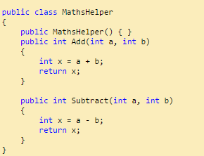
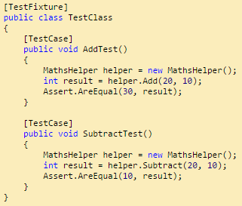
Example

Slide 6
Ways to run
NUnit Test Runner.
ReSharper Test Runner in IDE.
Visual Studio Runner.

Slide 7
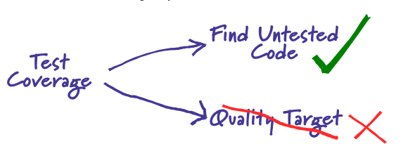
Test Coverage. Covering Each Case.
int m(int m){
if (m%2 ==0) return m*2;
return m*3;
}
[Test]
public void ShouldReturnExpectedNumberForEvenParam()
{
int n = 2;
var actual = m(n);
Assert.AreEqual(n*2, actual);
}

Slide 8

Test Coverage. Covering Each Case.
[Test]
public void ShouldReturnExpectedNumberForOddParam()
{
int n = 3;
var actual = m(n);
Assert.AreEqual(n*3, actual);
}

Slide 9
Test Quality.
Tests will be more qualitative:
if it will catch more corner cases.
if it will focus on user requirements.
if it might be used to deduce the specs and serve as a doc.
if it influences the design of the system.

Slide 10
Refactoring.
Code refactoring is the process of restructuring existing computer code – changing the factoring – without changing its external behavior.
Three steps:
find bad code aka “code smell”
Refactoring itself
Running unit-tests

Slide 11
Refactoring And tests.
“Walking on water and developing software from a specification are easy if both are frozen”. Edward V. Berard
Quality tests should freeze the specs of the system as below zero temperature freezes the water.
Tests are a safety net, not a guarantee, still you need to test manually.

Slide 12
Important Attributes
[SetUp]
SetUp is generally used for initialization purposes. Any code that must be initialized or set prior to executing a test is put in functions marked with this attribute. As a consequence, it avoids the problem of code repetition in each test.
2. [TearDown]
This is an attribute that acts the opposite of [SetUp]. It means the code written with this attribute is executed last

Slide 13
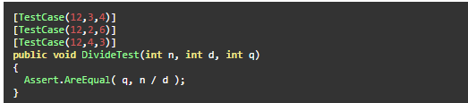
Important Attributes
3. [TestCase]
TestCaseAttribute serves the dual purpose of marking a method with parameters as a test method and providing inline data to be used when invoking that method

Slide 14
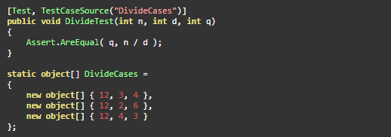
Important Attributes
4. [TestCaseSource]
TestCaseSourceAttribute is used on a parameterized test method to identify the property, method or field that will provide the required arguments.

Slide 15
Organizing Unit-tests
Fixture per class pattern
Fixture should be named according to type being tested, and suffixed with "Fixture" e.g. “MathFixture".
Test should contain the method you are testing, e.g. “DivideThrowsWhenDivizorIsZero" or “DivideShouldReturnExpectedResult".

Slide 16
Organizing Unit-tests
Fixture per method pattern
Base fixture class should be named according to type being tested, and suffixed with "Fixture" e.g. “MathFixture".
Method fixture class should be named according to method being tested, and suffixed with "Fixture" e.g. “DivideFixture".
Test should not contain method being tested since that is implied via its fixture. E.g. name test as "ItThrowsWhenDivizorIsZero" or “ItReturnsExpectedResult".

Slide 17
Organizing Unit-tests
Fixture per class with nested class
Create 1 TEST CLASS FOR EACH CLASS YOU WANT TO TEST.
CREATE NESTED CLASSES FOR EACH MEMBER OF THE CLASS UNDER TEST.
NAME NESTED CLASSES AND TEST METHODS SO THEY CONVEY WHAT ATTRIBUTE A MEMBER SHOULD HAVE.

Slide 18
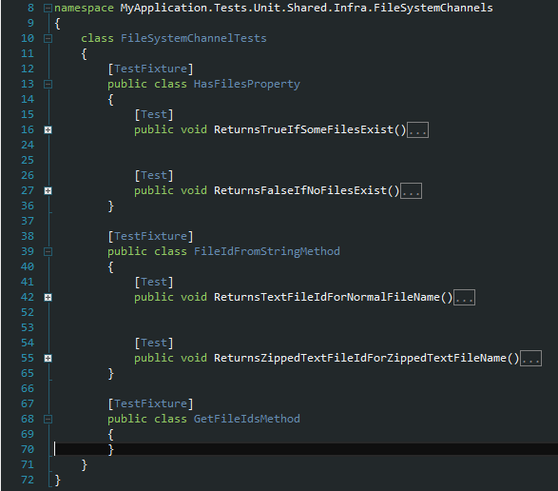
Organizing Unit-tests
Fixture per class with nested class example

Slide 19
Moq
Moq is the most popular and friendly mocking framework for .NET
public class ProductBusiness {
private readonly IProductDataAccess _productDataAccess;
public ProductBusiness(IProductDataAccess productDataAccess) {
_productDataAccess = productDataAccess;
}
public bool CreateProduct(Product newProduct) {
bool result = _productDataAccess.CreateProduct(newProduct);
return result;
}
}

Slide 20
Moq
[Test]
public void ItShouldCallCreateProduct() {
//arrange
var mockDataAccess = new Mock <IProductDataAccess>();
mockDataAccess.Setup(m = > m.CreateProduct(It.IsAny <Product> )).Returns(true);
var productBusiness = new ProductBusiness(mockDataAccess.Object);
//act
productBusiness.CreateProduct(new Product());
//assert
mockDataAccess.Verify(m = > m.CreateProduct(It.IsAny <Product> ), Times.Once())
}

Slide 21
TdD
In principle, it is just about writing the test before the program.
But in consequence, it leads the developer to first think about “how to use” the component (why do we need the component, what’s it for?)
and only then about “how to implement”.
So, it’s a testing technique as well as a design technique
It results into components that are easy to test. It results into components that are easy to enhance and adapt.
In the end, there is no code without a test.

Slide 22
TdD
The developer can tell at any time
whether everything still works as it should, or
what exactly does no longer work as it once did.

Slide 23
TdD. Motivation
If you intend to test after you‘ve developed the system, you won‘t have the time for testing. Write the tests before the code!
If things get complicated, you might fear that „the system“ doesn‘t work. Execute the tests and get positive feedback (everything still works) or get pointed to the bit that does not / no longer work.
If you‘re overwhelmed by the complexity, you get frustrated. Start with the simplest thing and proceed in tiny steps!

Slide 24
Red – Green – Refactor
Red. Write a little test that doesn‘t work (and perhaps doesn‘t even compile at first).
Green. Make the test work quickly (committing whatever sins necessary)
Refactor. Eliminate all of the duplication created in merely getting the test to work, improve the design.

Slide 25
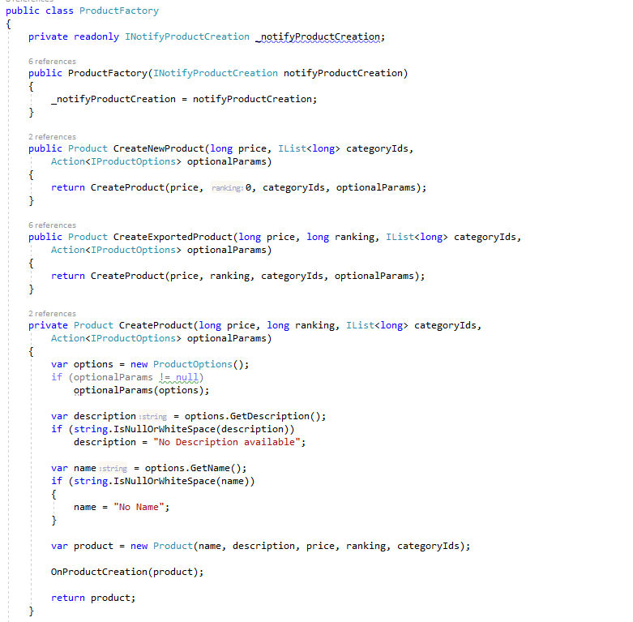
Test Examples

Slide 26
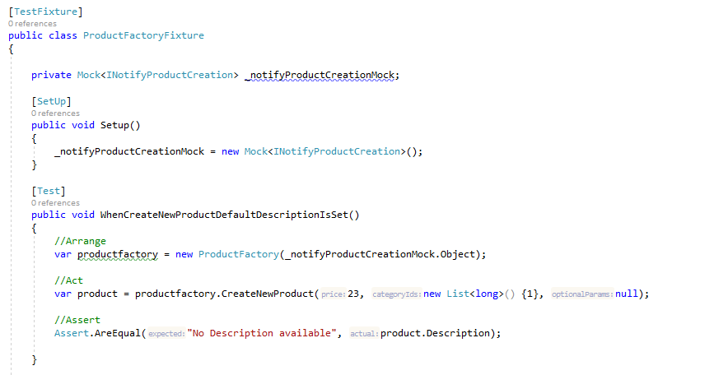
Test Examples

Slide 27
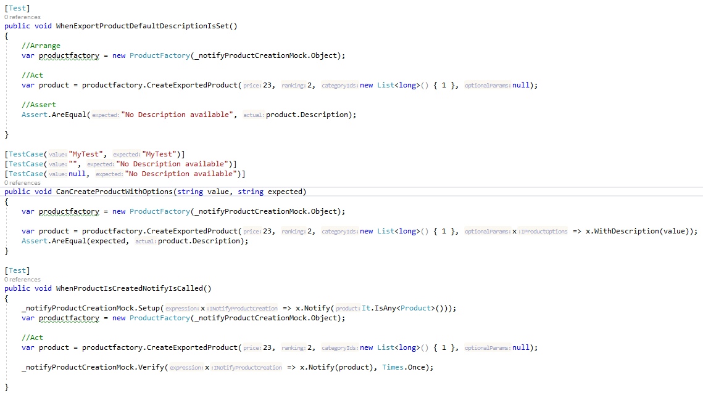
Test Examples

Slide 28
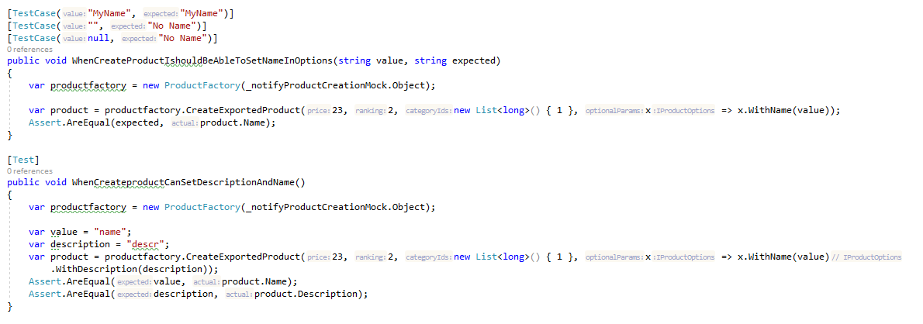
Test Examples

Slide 29
Why people like it?
The test is the executable specification.
You start thinking about the goal first, then about the possible implementations.
You understand the program‘s behavior by looking at the tests.
You develop just enough.
You get to the goal as quick as possible.
You don‘t develop unnecessary code.
There is no code without a test.
There is no test without a user requirement.
Once you get one test working, you know it is working now and forever.
You use the tests as regression tests.
The tests give us the courage to refactor.

Slide 30
Assignment
Unit-test a Developed class of your choice. Use AT LEAST TWO organizational Structures
Use attributes TestFixture, Test, TestCase, Setup.
Create A test Using Mock.
Try Writing A Fixture Using TDD.

